Slide 1


Специализированные технологии машинного обучения / Advanced Machine learning Technologies
Lecture 4 – Generative Models

Slide 2
Outline
Autoencoders (AEs): “encode -> code -> decode”
Latent variables and latent space;
Variational autoencoders (VAEs);
Generative Adversarial Networks (GANs).
Conditional Adversarial Networks (CGANs).

Slide 3
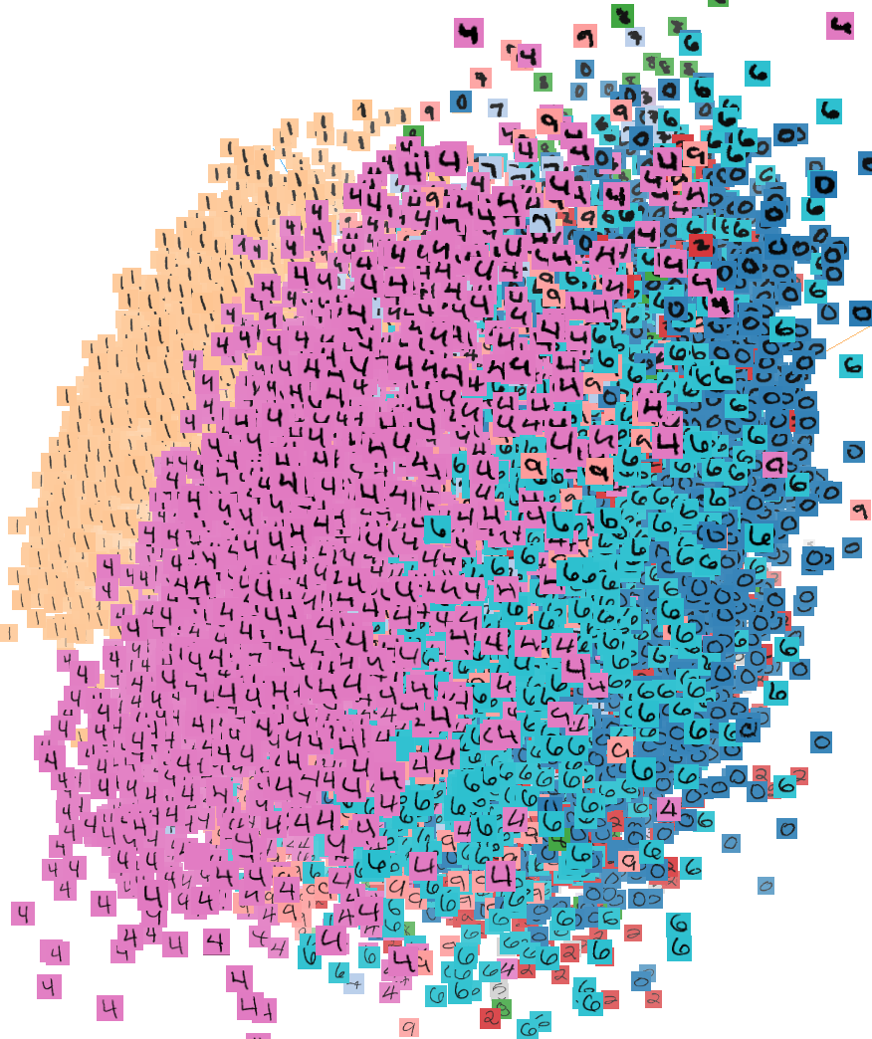
Unsupervised Learning
Unsupervised Learning
Data: X (no labels!)
Goal: Learn the structure of the data (density estimation)
Clustering/grouping,
Density estimation,
Dimensionality reduction,
? Autoencoders (AE),
? Variational AE (VAE)
? Generative Adversarial Networks (GAN)

Slide 4
Why Generative Models?
Supervised learning models are discriminative models
Given an image X, predict a label Y
Estimates P(Y|X)
Discriminative models have several key limitations
Can’t model P(X), i.e. the probability of seeing a certain image
Thus, can’t sample from P(X), i.e. can’t generate new objects
Unsupervised models
Estimate P(x) as density distribution but cannot sample new objects with desired properties
Generative models (in general) cope with all of above
Can model P(X)
Can generate new objects

Slide 5
Autoencoders
The autoencoder idea was a part of NN history for decades (LeCun et al, 1987).
Traditionally an autoencoder was used for dimensionality reduction and feature learning.
Recently, the connection between autoencoders and latent space modeling has brought variational autoencoders (VAEs) to the front of generative modeling.

Slide 6
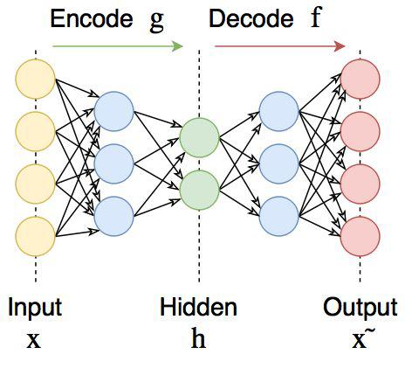
Autoencoders
Autoencoders try to learn Identity function, so that:
x~ = f(g(x)) = f(z) ≅ x
“dense” autoencoder
z
“latent variables”, “latent space”

Slide 7
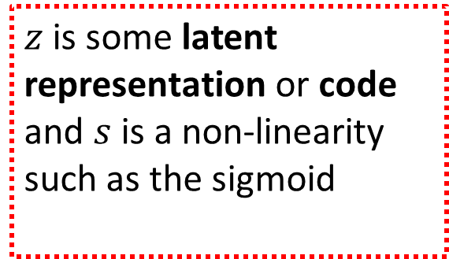
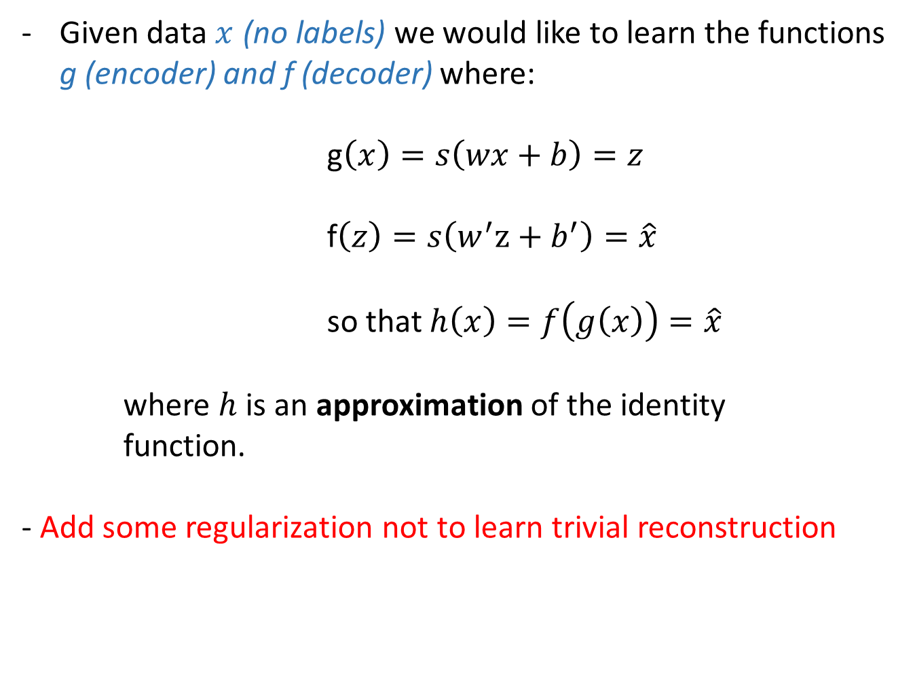
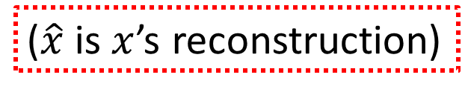
Autoencoders
Given data $x$ (no labels) we would like to learn the functions g (encoder) and f (decoder) where:
g$\left(x\right)=s\left(wx+b\right)=z$
f$\left(z\right)=s\left(w^{′}z+b^{′}\right)=\hat{x}$
so that $h\left(x\right)=f\left(g\left(x\right)\right)=\hat{x}$
where $h$ is an approximation of the identity function.
- Add some regularization not to learn trivial reconstruction
$z$ is some latent representation or code and $s$ is a non-linearity such as the sigmoid
($\hat{x}$ is $x$’s reconstruction)

Slide 8
Undercomplete AE vs overcomplete AE
Two basic types of AE structures:
output
output
input
input

Slide 9
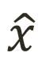
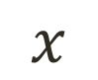
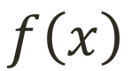
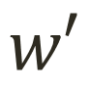

Undercomplete AE
Hidden layer is undercomplete if smaller than the input layer
Compresses the input => dimension reduction
Good features for representation of meaningful characteristics of the input data.
$$\hat{x}$$
$$w′$$
$$f\left(x\right)$$
$$w$$
$$x$$

Slide 10
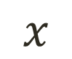
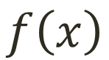


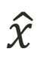
Overcomplete AE
Hidden layer is overcomplete if its dimension is greater than the input layer
No compression in hidden layer.
Each hidden unit could copy a different input component.
$$\hat{x}$$
$$w′$$
No guarantee that the hidden units will extract meaningful structure.
$$f\left(x\right)$$
A higher dimension code helps to model a more complex distribution.
Overfitting?
$$w$$
$$x$$

Slide 11
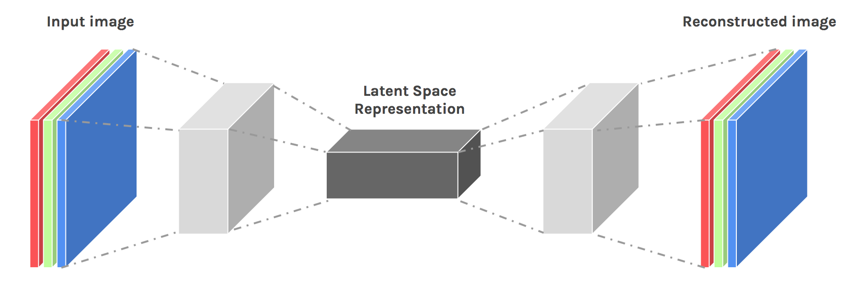
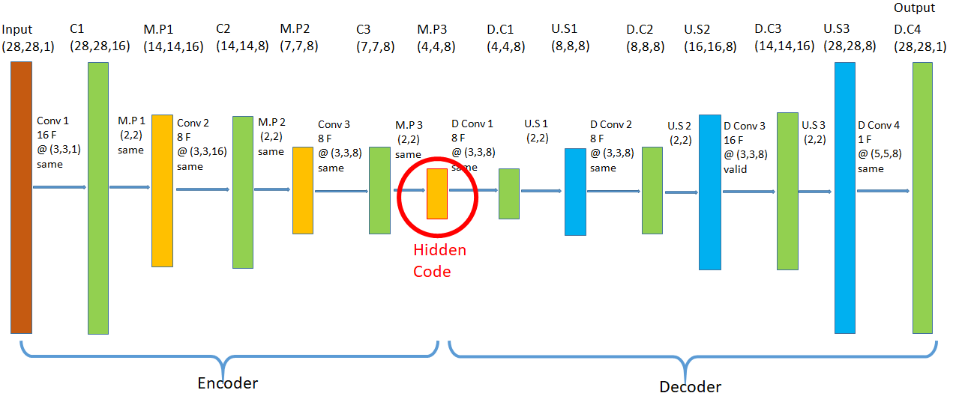
Convolutional AE

Slide 12
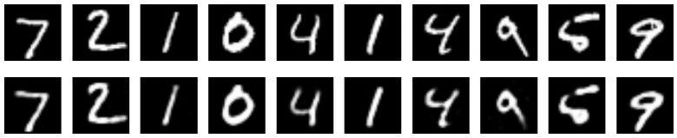
Keras example results
Dense AE:

Slide 13
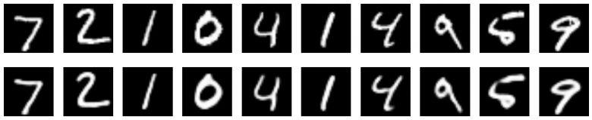
Keras example results
Dense AE:
Conv AE:

Slide 14
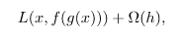
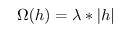
Regularization
Motivation:
We would like to learn meaningful features without varying the code’s dimensions (Overcomplete or Undercomplete).
Solution: apply other constraints to the training process.
→ Add regularization term to the loss function:
For example,
prevent overfitting;
more robust and meaningful codes (latent variables);
prevent learning trivial identity function;

Slide 15
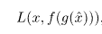
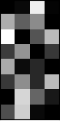
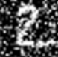
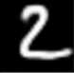
Denoising Autoencoders
Intuition:
Add some noise to the input and compare with clean data (train to reconstruct initial image)
A more robust model
Encoder
Decoder
Noisy Input
Denoised Input
Latent space representation

Slide 16
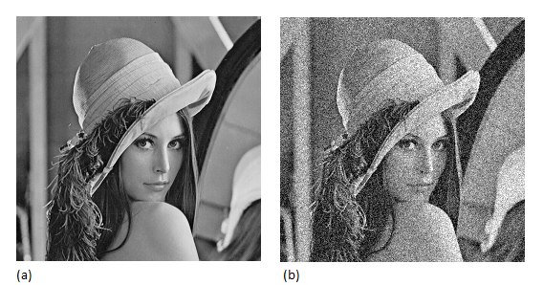
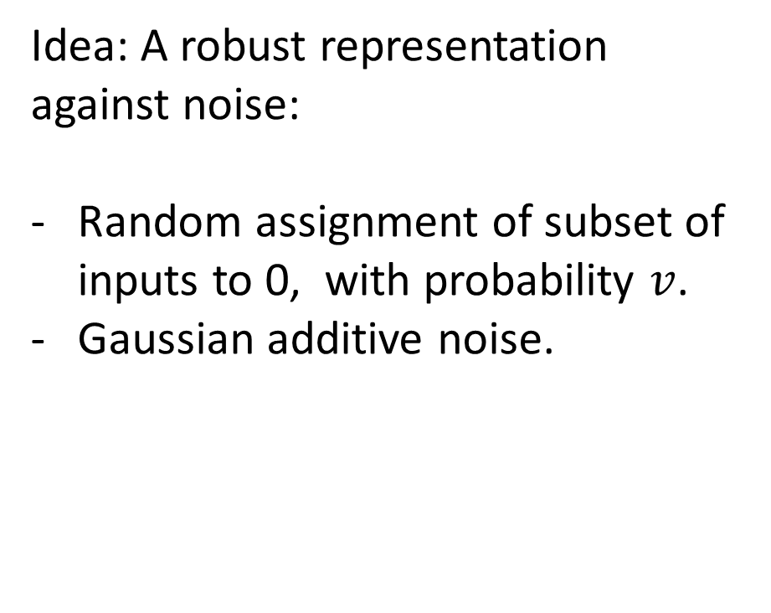
Denoising Autoencoders
Idea: A robust representation against noise:
Random assignment of subset of inputs to 0, with probability $v$.
Gaussian additive noise.
$$\hat{x}$$
$$w′$$
$$f\left(x\right)$$
$$w$$
$$x$$
Noise(μ,σ) +

Slide 17
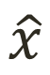

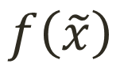

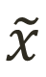
Denoising Autoencoders
Reconstruction is computed from noisy image;
Loss function compares prediction with the noiseless image;
We are forcing the hidden layer to learn a generalized structure of the data!
0
0
0

Slide 18
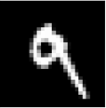
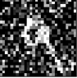
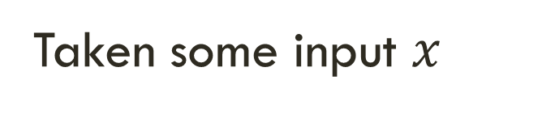
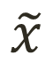
Denoising Autoencoders - process
Taken some input $x$
Apply Noise
$$\tilde{x}$$

Slide 19
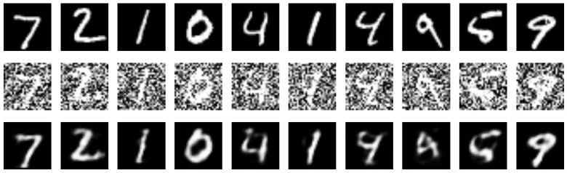
Denoising convolutional AE - example
Keras implementation result:

Slide 20
Latent space: motivation
Learning the identity function seems trivial, but with added constraints on the network (such as limiting the number of hidden neurons or/and regularization) we can learn information about the structure of the data
→ Trying to capture the distribution of the data
Let’s take a look at the codes….

Slide 21
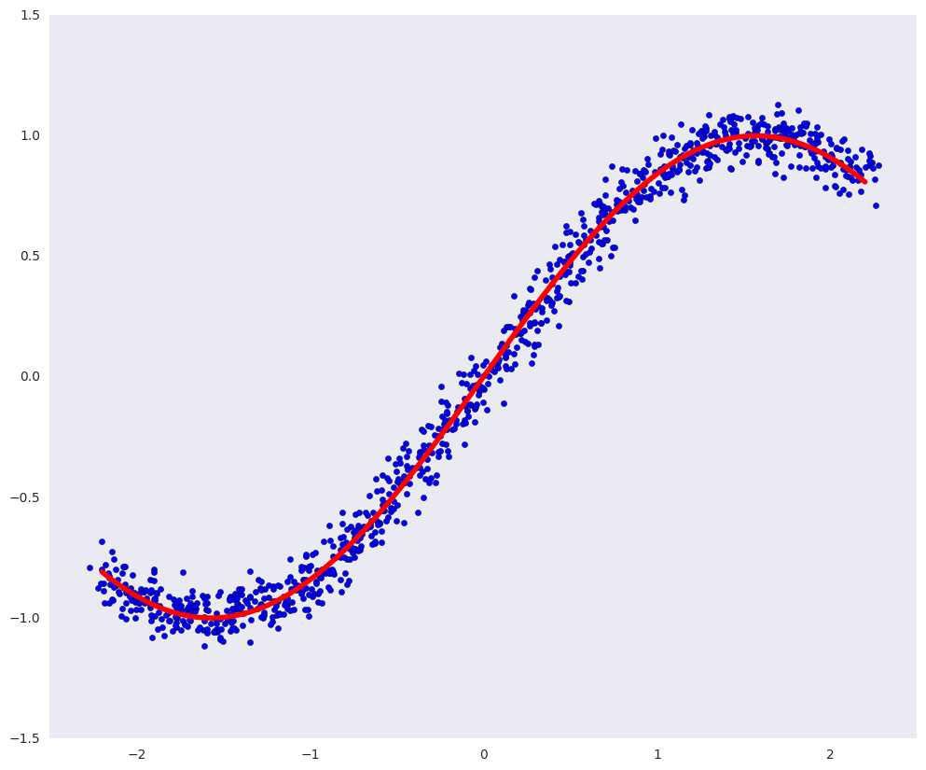
Latent space
Dots – initial distribution of the samples;
Red line – desirable manifold
(objects near the line are ~digit images)
https://habr.com/ru/post/331500/

Slide 22
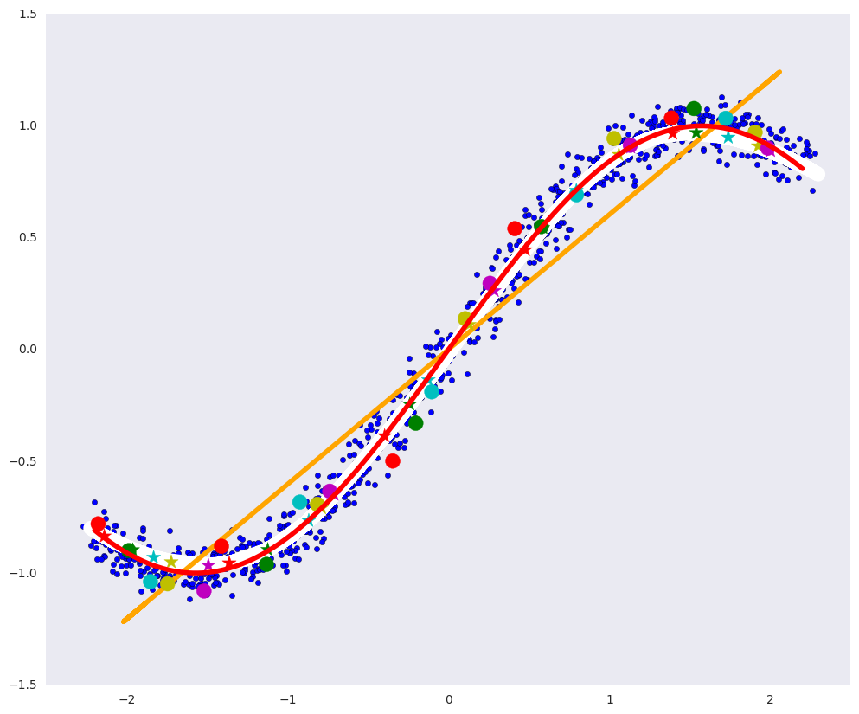
Latent space
the white line is the manifold to which the blue data points after the auto-encoder go, that is, the auto-encoder's attempt to construct the manifold that determines the most variations in the data;
The orange line is the manifold to which the blue data points go after the PCA;
colored circles - points that turn into asterisks of the corresponding color after encoding;
colored asterisks - respectively, the images of the circles after the auto-encoder.
White line – is “encoded manifold” or “latent space”
https://habr.com/ru/post/331500/

Slide 23
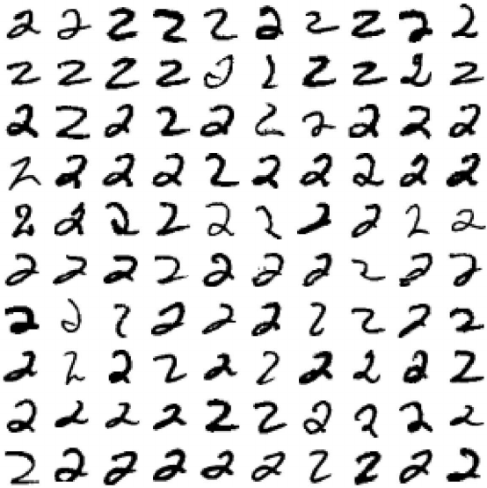
Latent variables
We can consider the general population as a process of generating data, which depends on a number of hidden variables (random variables).
The dimension of the data can be much higher than the dimension of the hidden random variables that these data define. Consider the process of generating the next digit: how the digit will look can depend on many factors:
desired numbers;
thickness of the stroke;
tilt
neatness;
Each of these factors has its own prior distribution.
For example, the probability that a figure of 8 will be drawn is the Bernoulli distribution with a probability of 1/10,
The thickness of the stroke also has some distribution and may depend on both accuracy and its hidden variables, such as the thickness of the handle or the temperament of a person (again with his distributions).
The auto-encoder itself in the learning process will (somehow) learn the hidden factors, for example, such as those listed above, some of their complex combinations.
Various types of “2”
However, the joint distribution that auto-encoder learns does not have to be simple, it can be some kind of complex curved area.

Slide 24
Code manifold and real world manifold:
If we take two objects and look at objects lying on an arbitrary curve between them, then most likely intermediate objects will not belong to the general population, since the variety on which the general population lies can be very curved and small.
moving in a straight line in the space of numbers from one “8” to another

Slide 25
Code manifold and real world manifold:
If we take two objects and look at objects lying on an arbitrary curve between them, then most likely intermediate objects will not belong to the general population, since the variety on which the general population lies can be very curved and small.
moving in a straight line in the space of numbers from one “8” to another
But if we move along a curve between codes (and if the code’s manifold is well parametrized), then the decoder will translate this curve from the code space to a curve that does not leave the defining manifold in the space of objects. That is, intermediate objects on the curve will belong to the entire population.
moving in a straight line in the space of codes from one “8-code” to another

Slide 26
Learning latent space
X — random sample (single image) from the dataset of 28х28 pixels images,
Z - a random value of hidden factors that determine the number in the picture
P(X) - the probability distribution of the images of the figures in the pictures, i.e. the probability of a particular image of a digit generally to be drawn (if the picture is not like a digit, then this probability is extremely small);
P(Z) - the probability distribution of hidden factors, for example, the distribution of the thickness of the stroke;
P(Z|X) - the probability distribution of hidden factors for a given picture (a different combination of hidden variables and noise can lead to the same picture);
P(X|Z) - the probability distribution of pictures for given hidden factors; the same factors can lead to different pictures (the same person in the same conditions does not draw exactly the same numbers);
P(Z,X) - joint distribution and, the most complete understanding of the data needed to generate new objects.

Slide 27
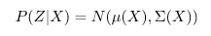
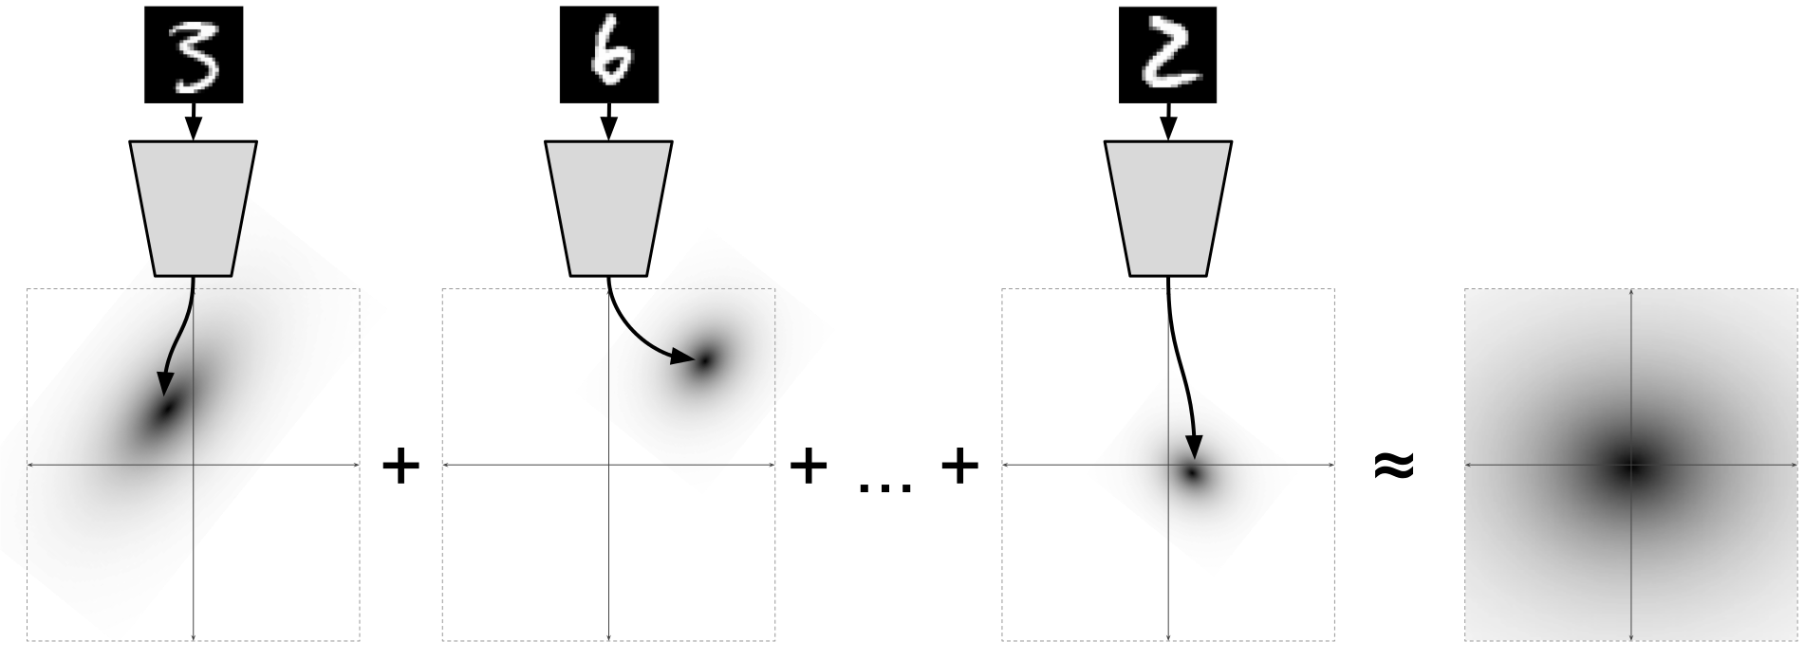
Learning latent space
http://ijdykeman.github.io/ml/2016/12/21/cvae.html
It can be shown (introducing specific loss function to encoder) that:
Encoder predict the parameters of some Normal distribution!
A variational autoencoder (VAE) is a generative model that learns to map objects into a given hidden space and than to generate the new objects as decoded samples from this hidden space.

Slide 28
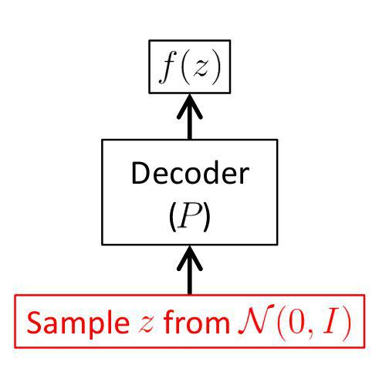
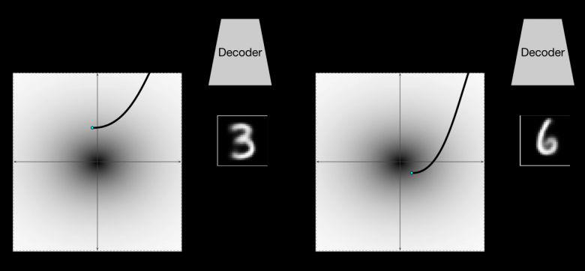
For example, we can sample from P(z) ~ N(0,1) distribution to decode new digits:
Variational Autoencoders
In order to be able to generate new objects, the space of hidden variables (latent variables) must be predictable. VAE are autoencoders that learn to map objects into a given latent space and, therefore, sample them.
Therefore, variational autoencoders are also referred to the family of generative models.
New digit!
Hidden latent space
Hidden latent space
Conditional VAE: add new information to the input → new objects with desirable features (thickness or style)!
http://ijdykeman.github.io/ml/2016/12/21/cvae.html
https://habr.com/ru/post/331664/

Slide 29
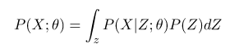
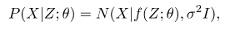
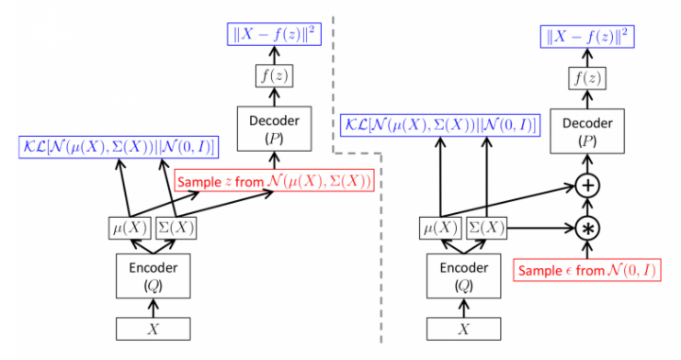
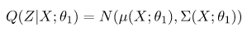
VAE architecture
- want to maximize
- KL divergence
We can fix that encoder should generate hidden parameters from the multivariate Gaussian distribution:
It can be shown that:

Slide 30
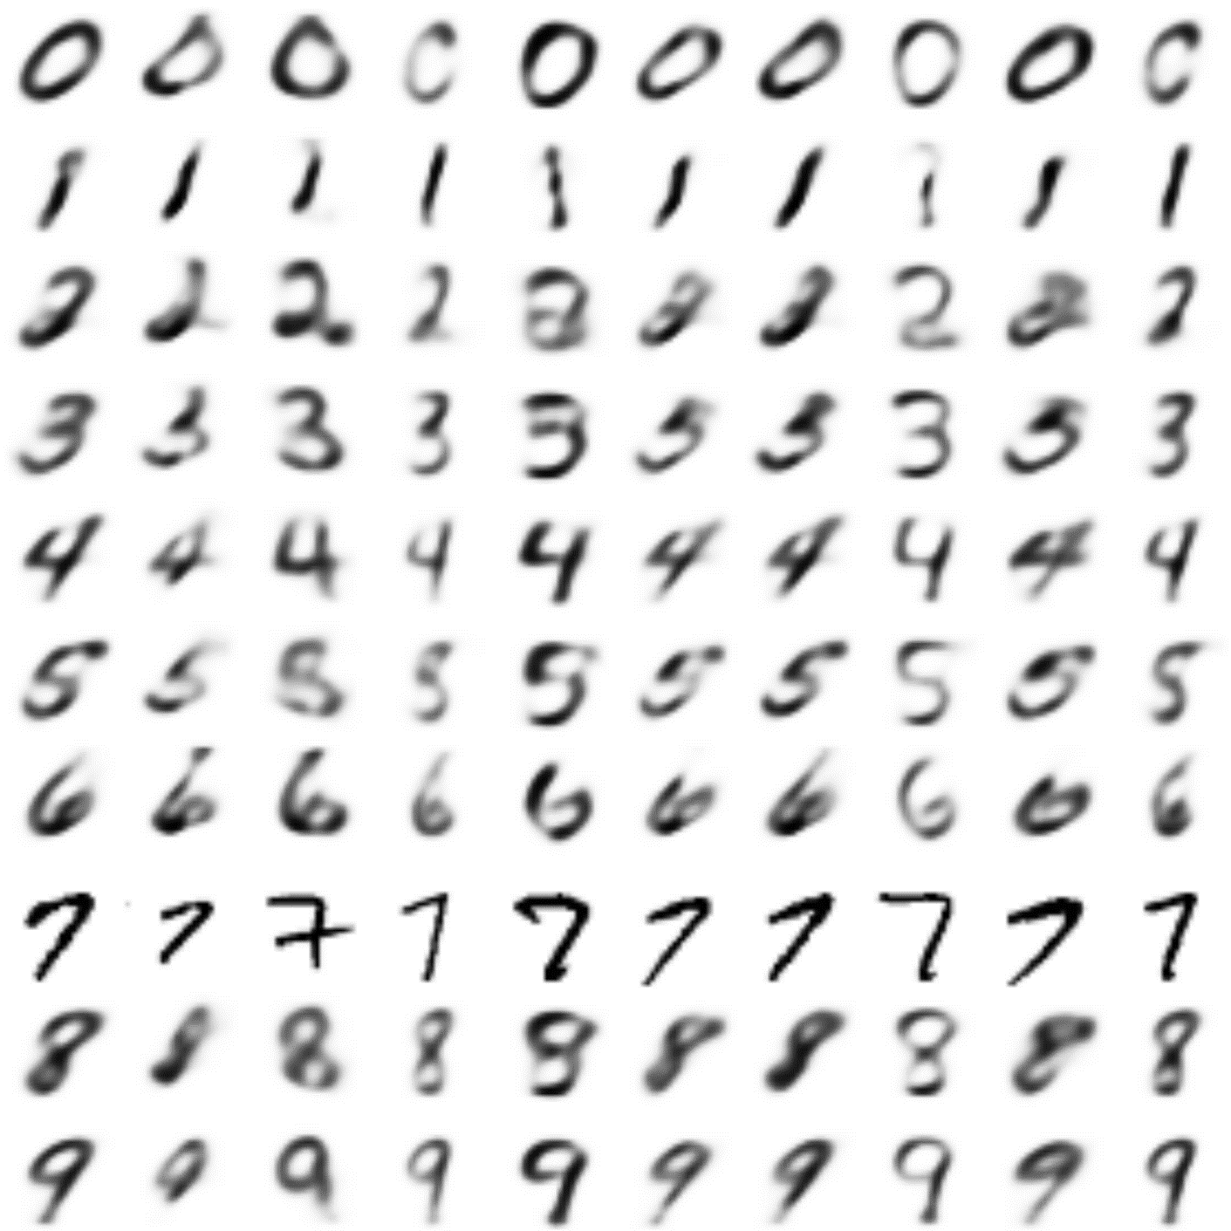
VAE example

Slide 31
GANs

Slide 32
GANs
Generative
Learn a generative model – to generate smth new
Adversarial
Trained in an adversarial setting: generator vs. discriminator
Networks
Use Deep Neural Networks

Slide 33
Magic of GANs…
Generate 2D/3D shapes ➔ helpful for designers (rendering)
Ledig, Christian, et al. "Photo-realistic single image super-resolution using a generative adversarial network." arXiv preprint arXiv:1609.04802 (2016).

Slide 34
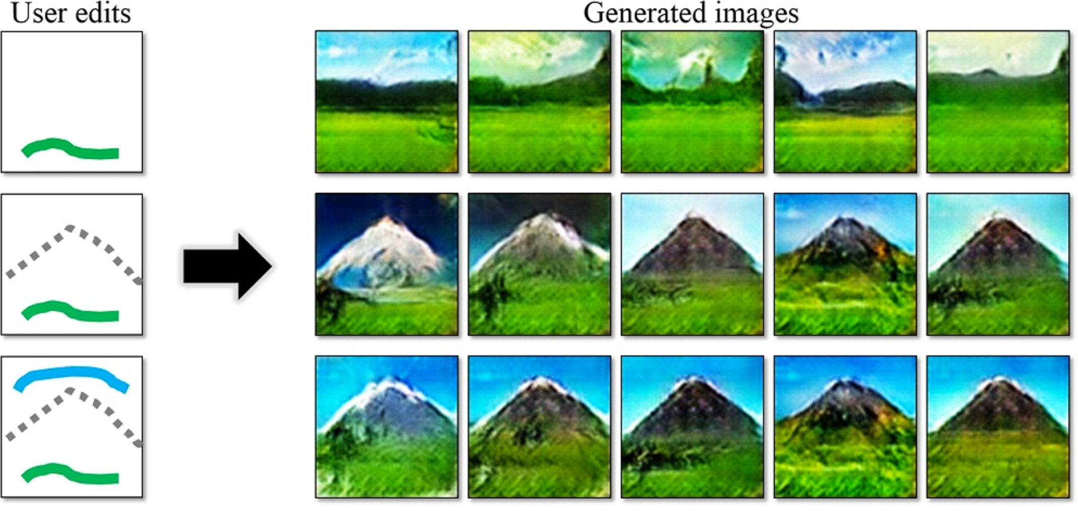
Magic of GANs…
Generate new images and videos ➔ helpful for artists
http://people.eecs.berkeley.edu/~junyanz/projects/gvm/

Slide 35
Applications using GANs
Font generation
Anime character generation
Interactive Image generation
Text2Image (text to image)
3D Object generation
Image Editing
Face Aging
Human Pose Estimation
Domain-transfer (e.g. style-transfer, pix2pix, sketch2image)
Image Inpainting (hole filling)
Super-resolution
High-resolution image generation (large-scale image)
Adversarial Examples (Defense vs Attack)
Visual Saliency Prediction (attention prediction)
Robotics
Video (generation/prediction)
Synthetic Data Generation
Real-time face reconstruction
Photorealistic Image generation (e.g. pix2pix, sketch2image)
Human Pose Estimation
…

Slide 36
Adversarial Training
GANs extend the idea of discriminative modeling:
Generator: generate fake samples, tries to fool the Discriminator
Discriminator: tries to distinguish between real and fake samples
Train them against each other (separately)
Repeat this and we get better Generator and Discriminator
=> receive more realistic generated objects!

Slide 37
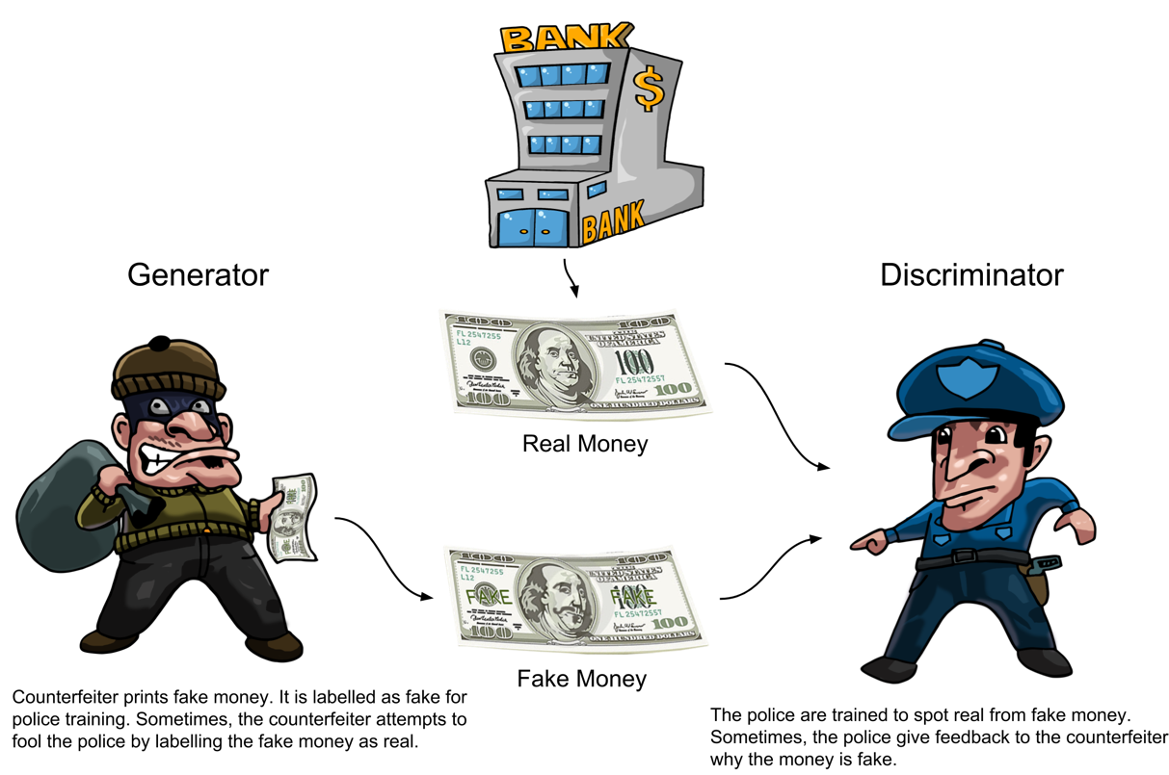
Policeman vs. Counterfeiter

Slide 38
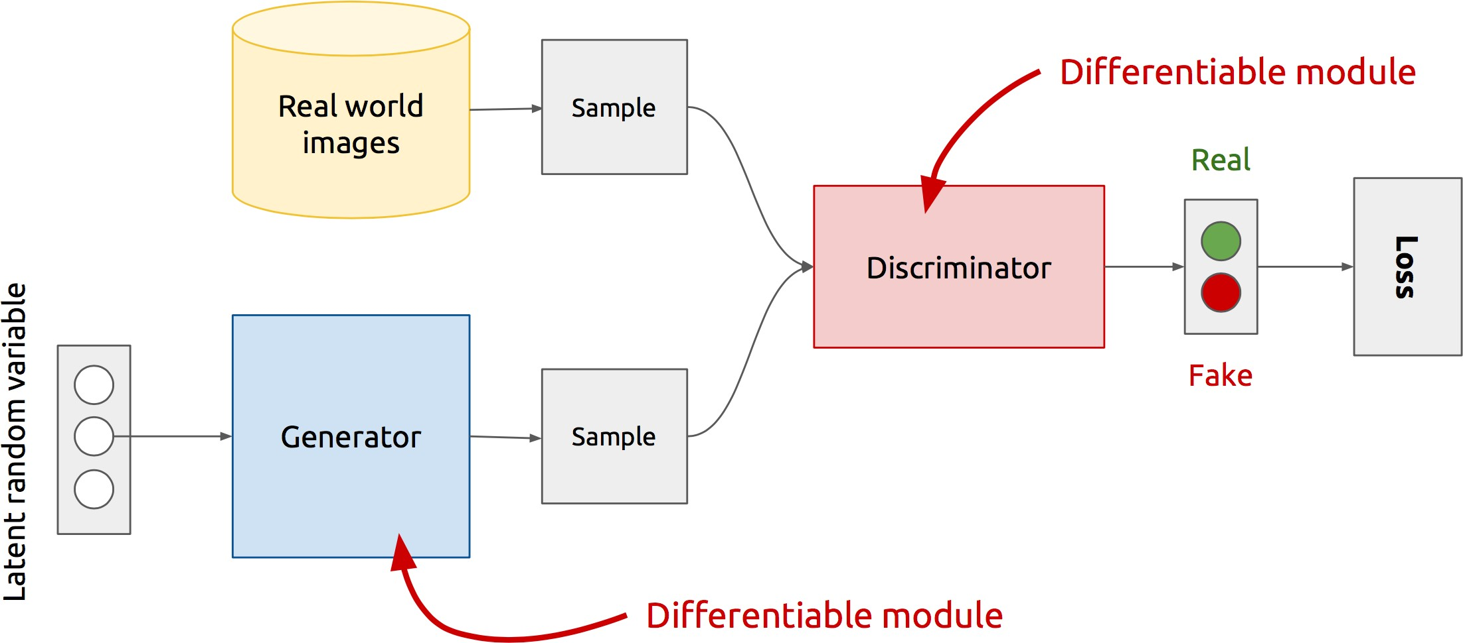
GAN’s Architecture
x
D
D(x)
G
z
G(z)
D(G(z))
Discriminator solve binary classification problem:
«0» - is for the fake
“1” – is for the real
Z is some random noise (Gaussian/Uniform).
Z can be thought as the latent representation of the image.
https://www.slideshare.net/xavigiro/deep-learning-for-computer-vision-generative-models-and-adversarial-training-upc-2016

Slide 39
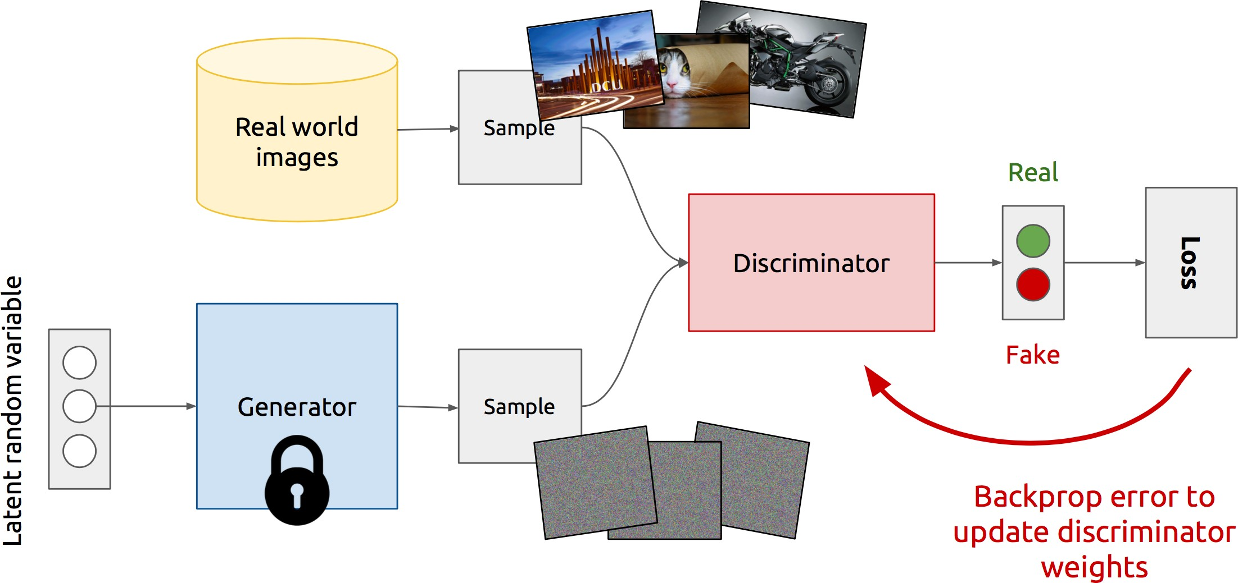
Training Discriminator
Training separately!
https://www.slideshare.net/xavigiro/deep-learning-for-computer-vision-generative-models-and-adversarial-training-upc-2016

Slide 40
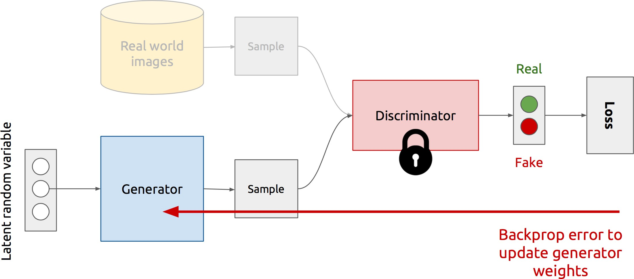
Training Generator
Training separately!
https://www.slideshare.net/xavigiro/deep-learning-for-computer-vision-generative-models-and-adversarial-training-upc-2016

Slide 41
GAN’s formulation
GANs training process is formulated as a minimax game, where:
The Discriminator is trying to maximize its reward 𝑽 𝑫, 𝑮
The Generator is trying to minimize Discriminator’s reward (== maximize its loss)
𝑉 𝐷, 𝐺 = 𝔼_{x∼p(x)} log 𝐷 𝑥 + 𝔼_{z~q(z)} log 1 − 𝐷 𝐺(𝑧)
where:
x ⊂ X – real samples
G(z) – generated samples
1 − 𝐷(𝐺(𝑧)) – probability of predicting “real” label
G – generator
D – discriminator
D(x)=1, if discriminator has labeled x as real
D(x)=0, if discriminator has labeled x as fake

Slide 42
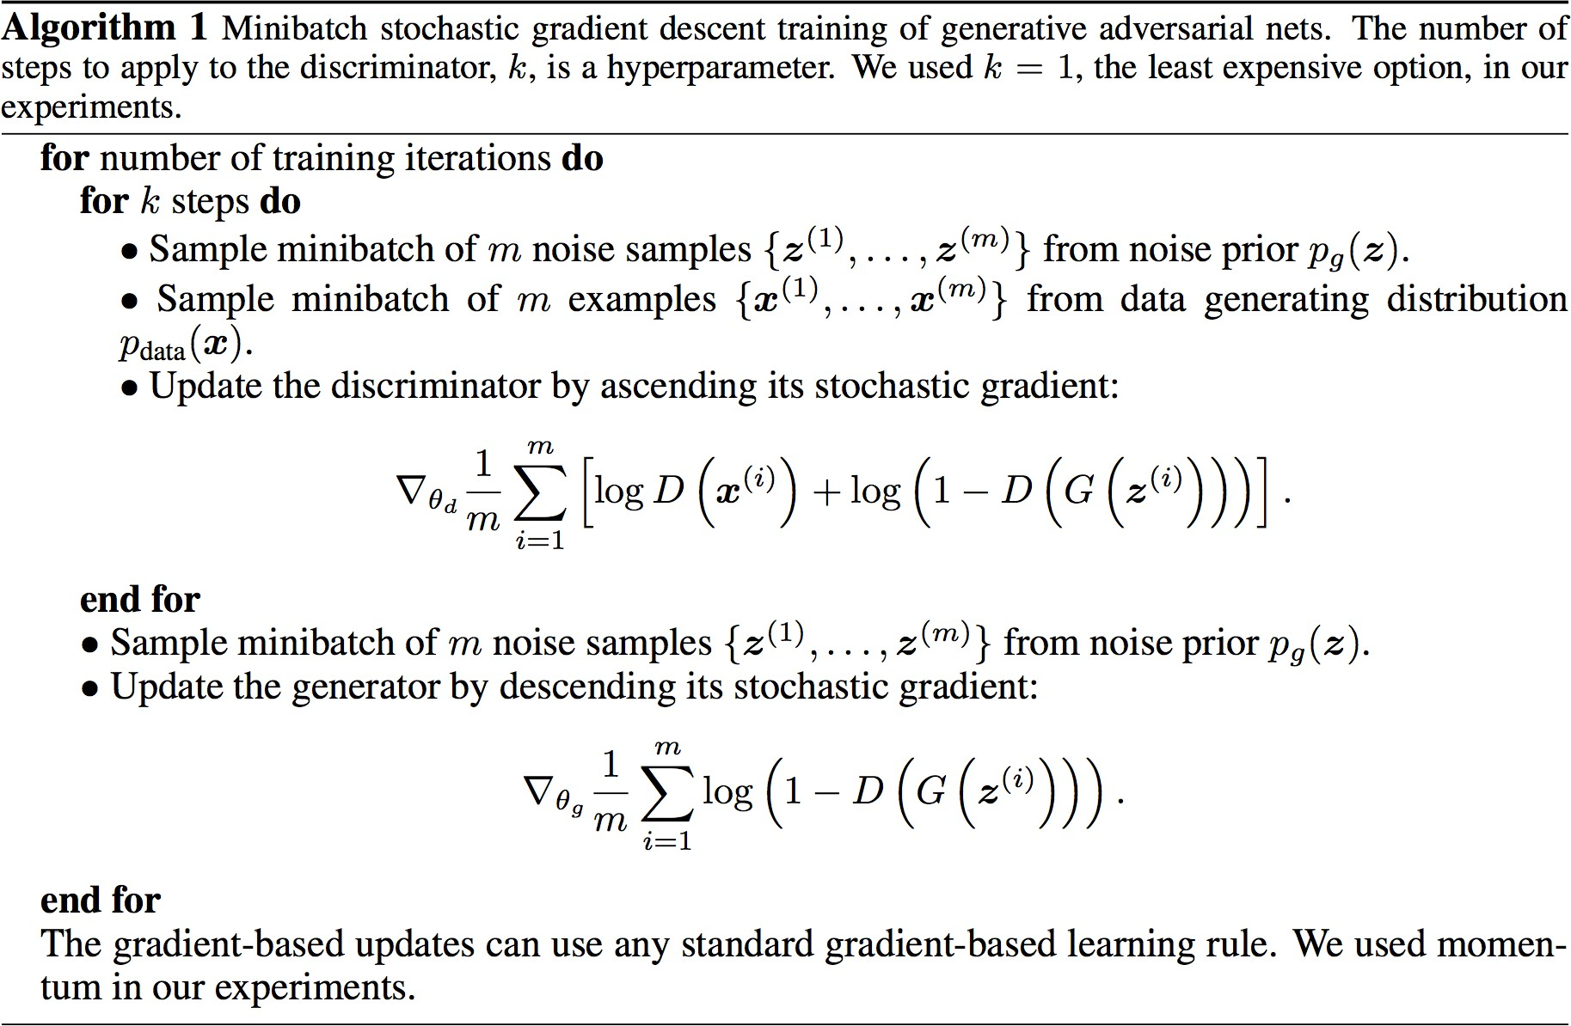
Discriminator updates
GAN’s training algorithm
Generator updates

Slide 43

Deep Convolutional GANs (DCGANs)
Key ideas:
Replace FC hidden layers with Convolutions
Generator: Fractional-Strided convolutions
Use Batch Normalization after each layer
Inside Generator
Use ReLU for hidden layers
Use Tanh for the output layer
Generator Architecture
Radford, Alec, Luke Metz, and Soumith Chintala. "Unsupervised representation learning with deep convolutional generative adversarial networks." arXiv:1511.06434 (2015).

Slide 44


Example

Slide 45

DCGAN: bedroom images
Radford, Alec, Luke Metz, and Soumith Chintala. "Unsupervised representation learning with deep convolutional generative adversarial networks." arXiv:1511.06434 (2015).

Slide 46

Latent vectors with additional labels capture interesting patterns…
Learning meaningful latent space
Radford, Alec, Luke Metz, and Soumith Chintala. "Unsupervised representation learning with deep convolutional generative adversarial networks." arXiv:1511.06434 (2015).

Slide 47

GANs and cGANs (I)
GANs:
G – a generative model;
D – a discriminative model;
x – training real data;
z – data generated by G;
If both the generator and the discriminator are conditioned on some extra information y:
- conditional GAN (cGAN);
47

Slide 48

GANs and cGANs (II)
48

Slide 49

GANs and cGANs (III)
https://medium.com/datadriveninvestor/an-introduction-to-conditional-gans-cgans-727d1f5bb011

